Slide 1
30 June – 2 July, 2017
Gandhinagar, Gujarat, India
www.textilesindia2017.com
Government of India

Slide 2
Textiles India 2017
To position Textiles India as a mega Annual International Event bringing global & Indian leaders together on one platform.
Showcase India’s strength in the entire gamut of textile and apparel value chain, from farm to fibre to fabric to fashion.
Establish India as a global sourcing and investment destination.

Slide 3
Key Elements
Conferences
B2B & B2G Meetings
Country
sessions
Theme Pavilion
Fashion Shows
State
sessions
Roundtables by Industrial Associations/ Councils
Exhibitions

Slide 4
Schedule
DAY 1
30th June, 2017
Inauguration by Hon’ble Prime Minister of India
Opening of International Exhibition
Fashion shows
Day 2
1st July, 2017
International Exhibition
Country Sessions
State Sessions
Fashion Shows
Roundtables by Industrial Associations/ Councils/ Institutions
B2B, B2G & G2G Meetings
DAY 3
2nd July, 2017
International Exhibition
B2B, B2G & G2G Meetings
Sectoral seminars
Valedictory session

Slide 5
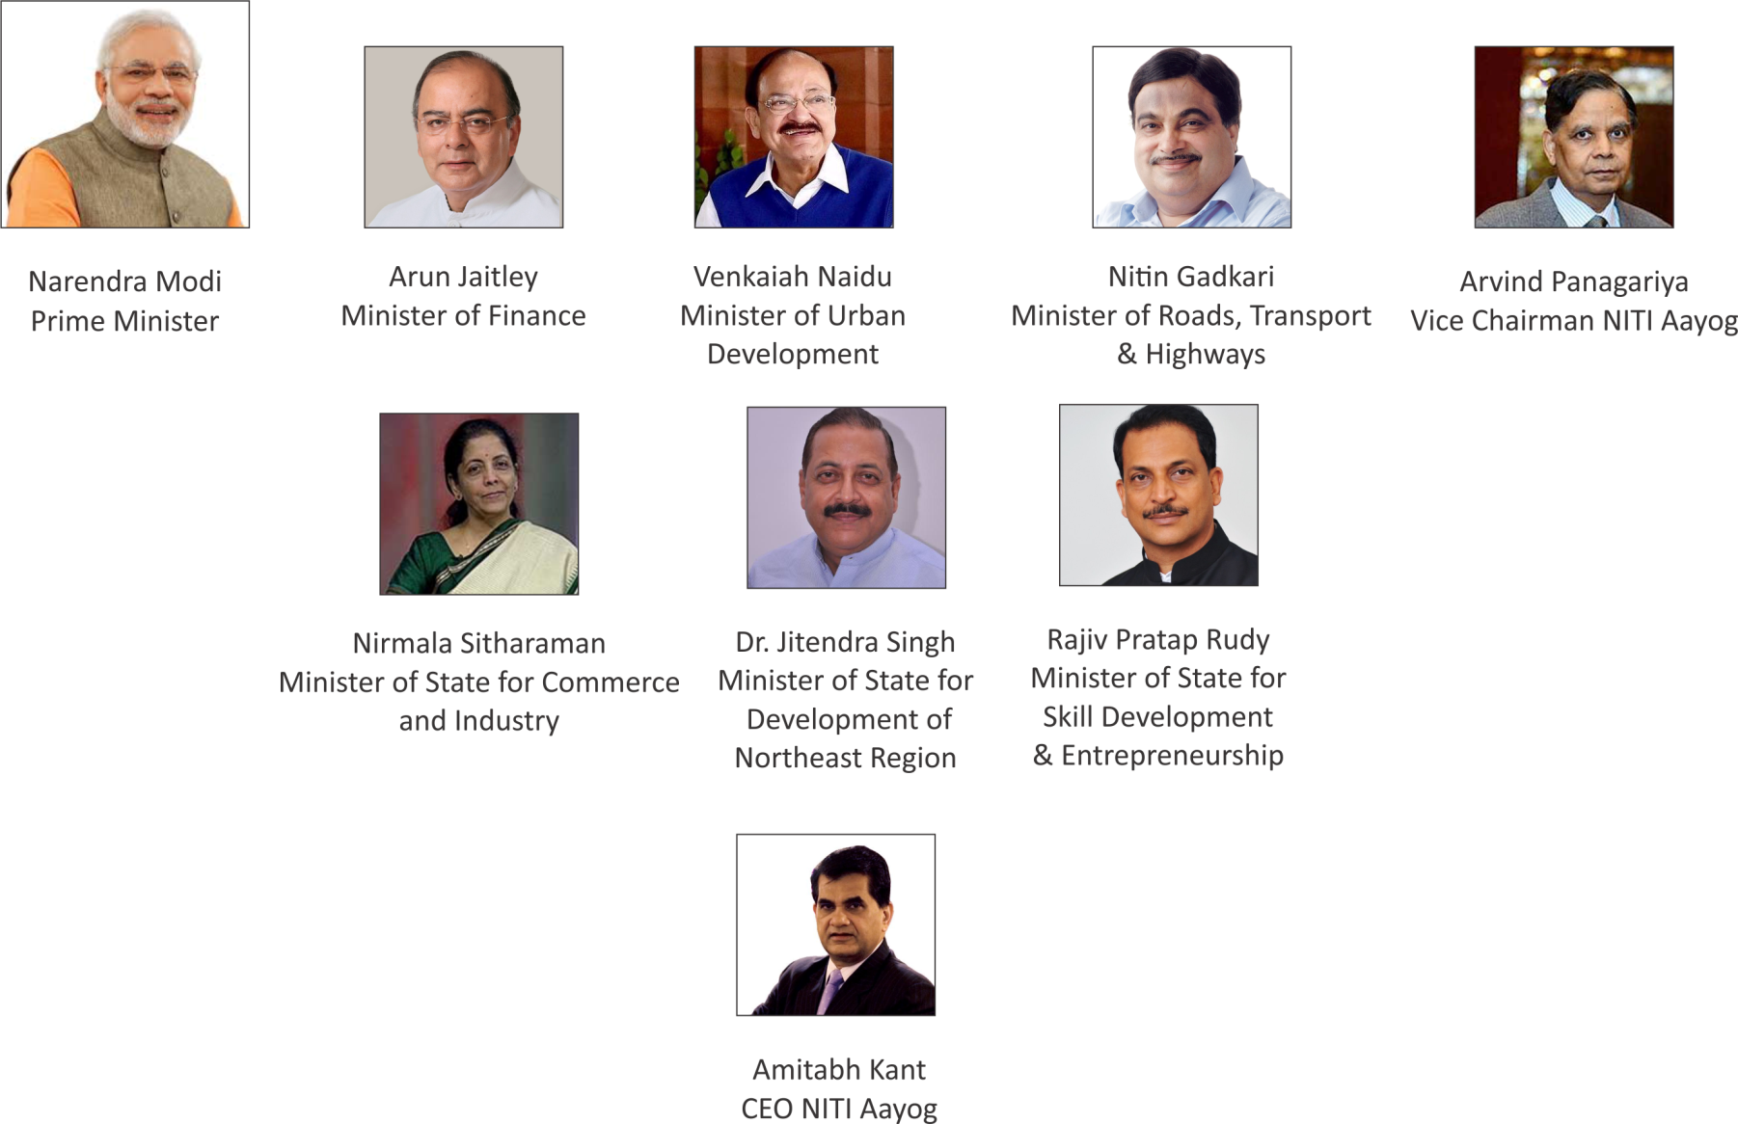
Eminent Dignitaries
As on March 2017

Slide 6
State Representation
Vijay Rupani
Chief Minister, Gujarat
Sarbananda Sonowal
Chief Minister, Assam
P. Siddaramaiah
Chief Minister, Karnataka
N Chandrababu Naidu
Chief Minister, Andhra Pradesh
Raghubar Das
Chief Minister, Jharkhand
As on March 2017

Slide 7
Participating Organizations/Institutions

Slide 8
Exhibition spread across 1,25,000 sq. Mts.

Slide 9
Event Structure
1. International Conference/ Roundtables
2. Mega Exhibition
3. Allied Activities
5 Union Ministers to Chair conferences on various themes
About 33 round tables by Industry Associations/ Councils
Signing of MoUs with Countries/ States/ Associations/ Institutions
B2B, B2G, G2G Meetings
About 1000+ exhibitors to showcase their products and services
2500 + International Buyers; 15000 + Domestic buyers
Dedicated Pavilions : Startups, Skills, R&D, Sustainability
Fashion shows
Thematic display of textile and apparel products
Cultural programmes
Best display and design awards

Slide 10
Proposed Conference Themes
India as a global sourcing hub and an investment destination
Exploring growth potential of technical textiles
Productivity and product diversification challenges for natural fibres
Skilling requirements in high value chain in the textiles sector
Carving a niche market world over for Indian handcrafted goods

Slide 11
Proposed themes for the Roundtables
UNESCO | Silk Routes – revival of silk exports
IIT Kharagpur, CSB with their Counterpart organization in China | Potential of silk Bye products for commercial use and R&D on silk
Silk
ITTA in association with International Organizations on Technical Textiles | Scope of technical textiles in Meditech
Leading industry in sportech | Potential for Sportech in India
BIS | Standards in technical textiles
SASMIRA | Nanotechnology for Technical Textiles
Technical Textiles

Slide 12
Proposed themes for the Roundtables
CRIJAF and International Natural Fiber Organisation, Netherlands | Sustainability of Jute and Allied Natural Fibers
IJMA and JPDEPC | Jute Exports Penetration of new markets
IJIRA in association with the premier institute/ agency in Bangladesh | Research in Innovative use of Jute including Non-Wovens and composites
Jute
SASMIRA | Water less textile processing Technology
IIT Bombay and NID | 3 D printing
TWICS/ILFS | Zero liquid discharge systems
Processing

Slide 13
Proposed themes for the Roundtables
Ministry of Tribal Affairs and NID | Tribal weaves of India
CMAI | Market linkages with retail chains
Handlooms
UNESCO and Crafts Council of India | Revival of endangered crafts
SANDHI team, IIT Kanpur and CAPART | Technology and handicrafts
AIACA | Branding
Handicrafts
Branding
NHDC, IBEF | Branding and quality assurance

Slide 14
Proposed themes for the Roundtables
NIFT | Trends in colors and designs
CEPC, Jaipur Rug Academy | Exploring new export markets, Technology for the designing, promotion and marketing of handmade carpets
Carpets
AEPC | Capacity building in Readymade Garment, Made ups and MMF
NIFT | Size India
CMAI | Robotics and Manufacturing
RMG and Made ups

Slide 15
Proposed themes for the Roundtables
WRA | Exploring innovations through Design and application in industrial products
Indian Woolen Mills Federation/ Indian Institute of Carpet Technology /HP Woolfed, Shimla | Productivity and marketing constraints in wool sector
Wool
DIPP Start Up /Stand Up India | Women Entrepreneurship development
WEF | Young Entrepreneurs
Skills

Slide 16
Proposed themes for the Roundtables
Calcutta University /IJT | Jute based Municipal Waste Management technology
IIT Kanpur ATIRA | Use of flexible electronic in communication system or Composites in space technology.
NITRA/Wadia Institute of Himalayan Geology, GB Pant National Institute of Himalayan Environment | Commercial production of plant fibre of Himalayan foothills
R&D
IIFT | Potential for Exports
Invest India | Ease of Doing Business
Exports

Slide 17
Proposed themes for the Roundtables
Sidddharth Rajagopal | King Cotton
Suresh Kotak | Cottonomics – Green Cotton Clean cotton
Manikam Ramaswamy | Current Trends & Innovations
Cotton

Slide 18
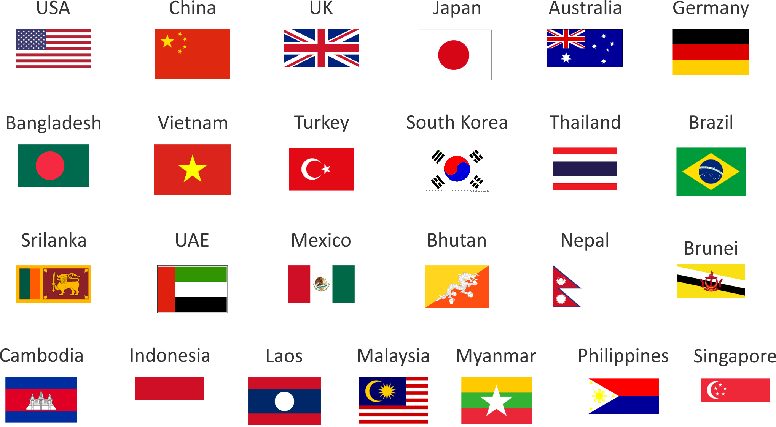
Participating Countries

Slide 19
Participating Ministries
Ministry of Finance
Ministry of Commerce
Ministry of Heavy Industry
Ministry of Agriculture & Farmers Welfare
Ministry of Development of North East Region
Ministry of Urban Development
Ministry of Skill Development and Entrepreneurship
Ministry of Tourism
Ministry of Environment and Forest
Ministry of Roads, Transport and Highways
Ministry of Micro, Small and Medium Enterprises
Ministry of Rural Development
Ministry of Health

